Slide 1
Project work
gruppo 2 - software architecture design 2024/2025
3rd sprint release presentation

Slide 2
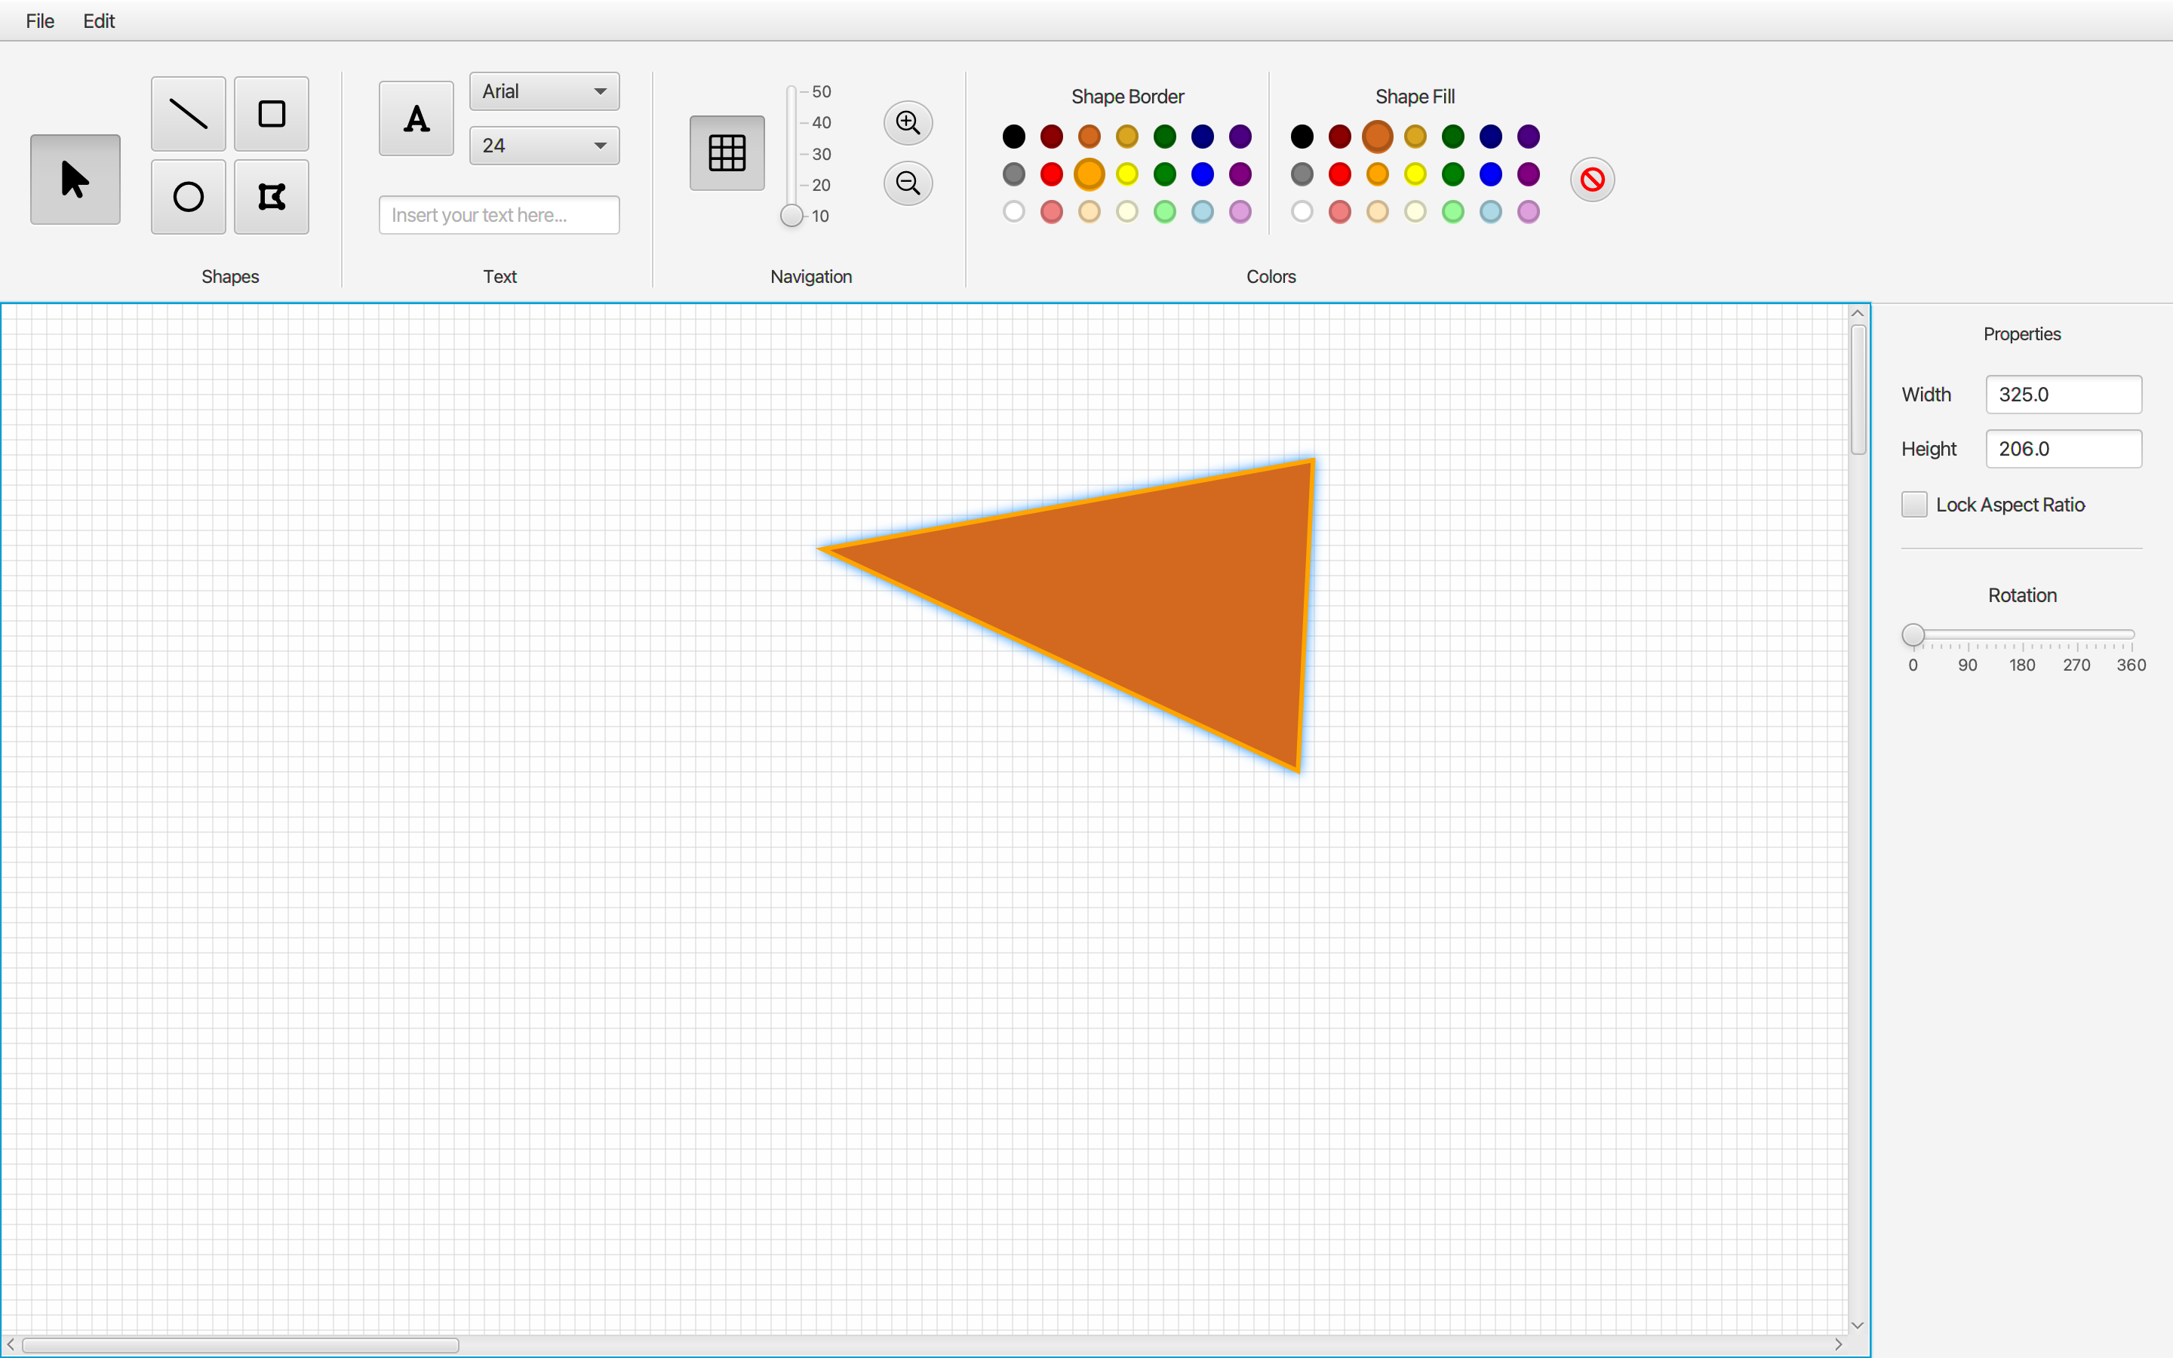
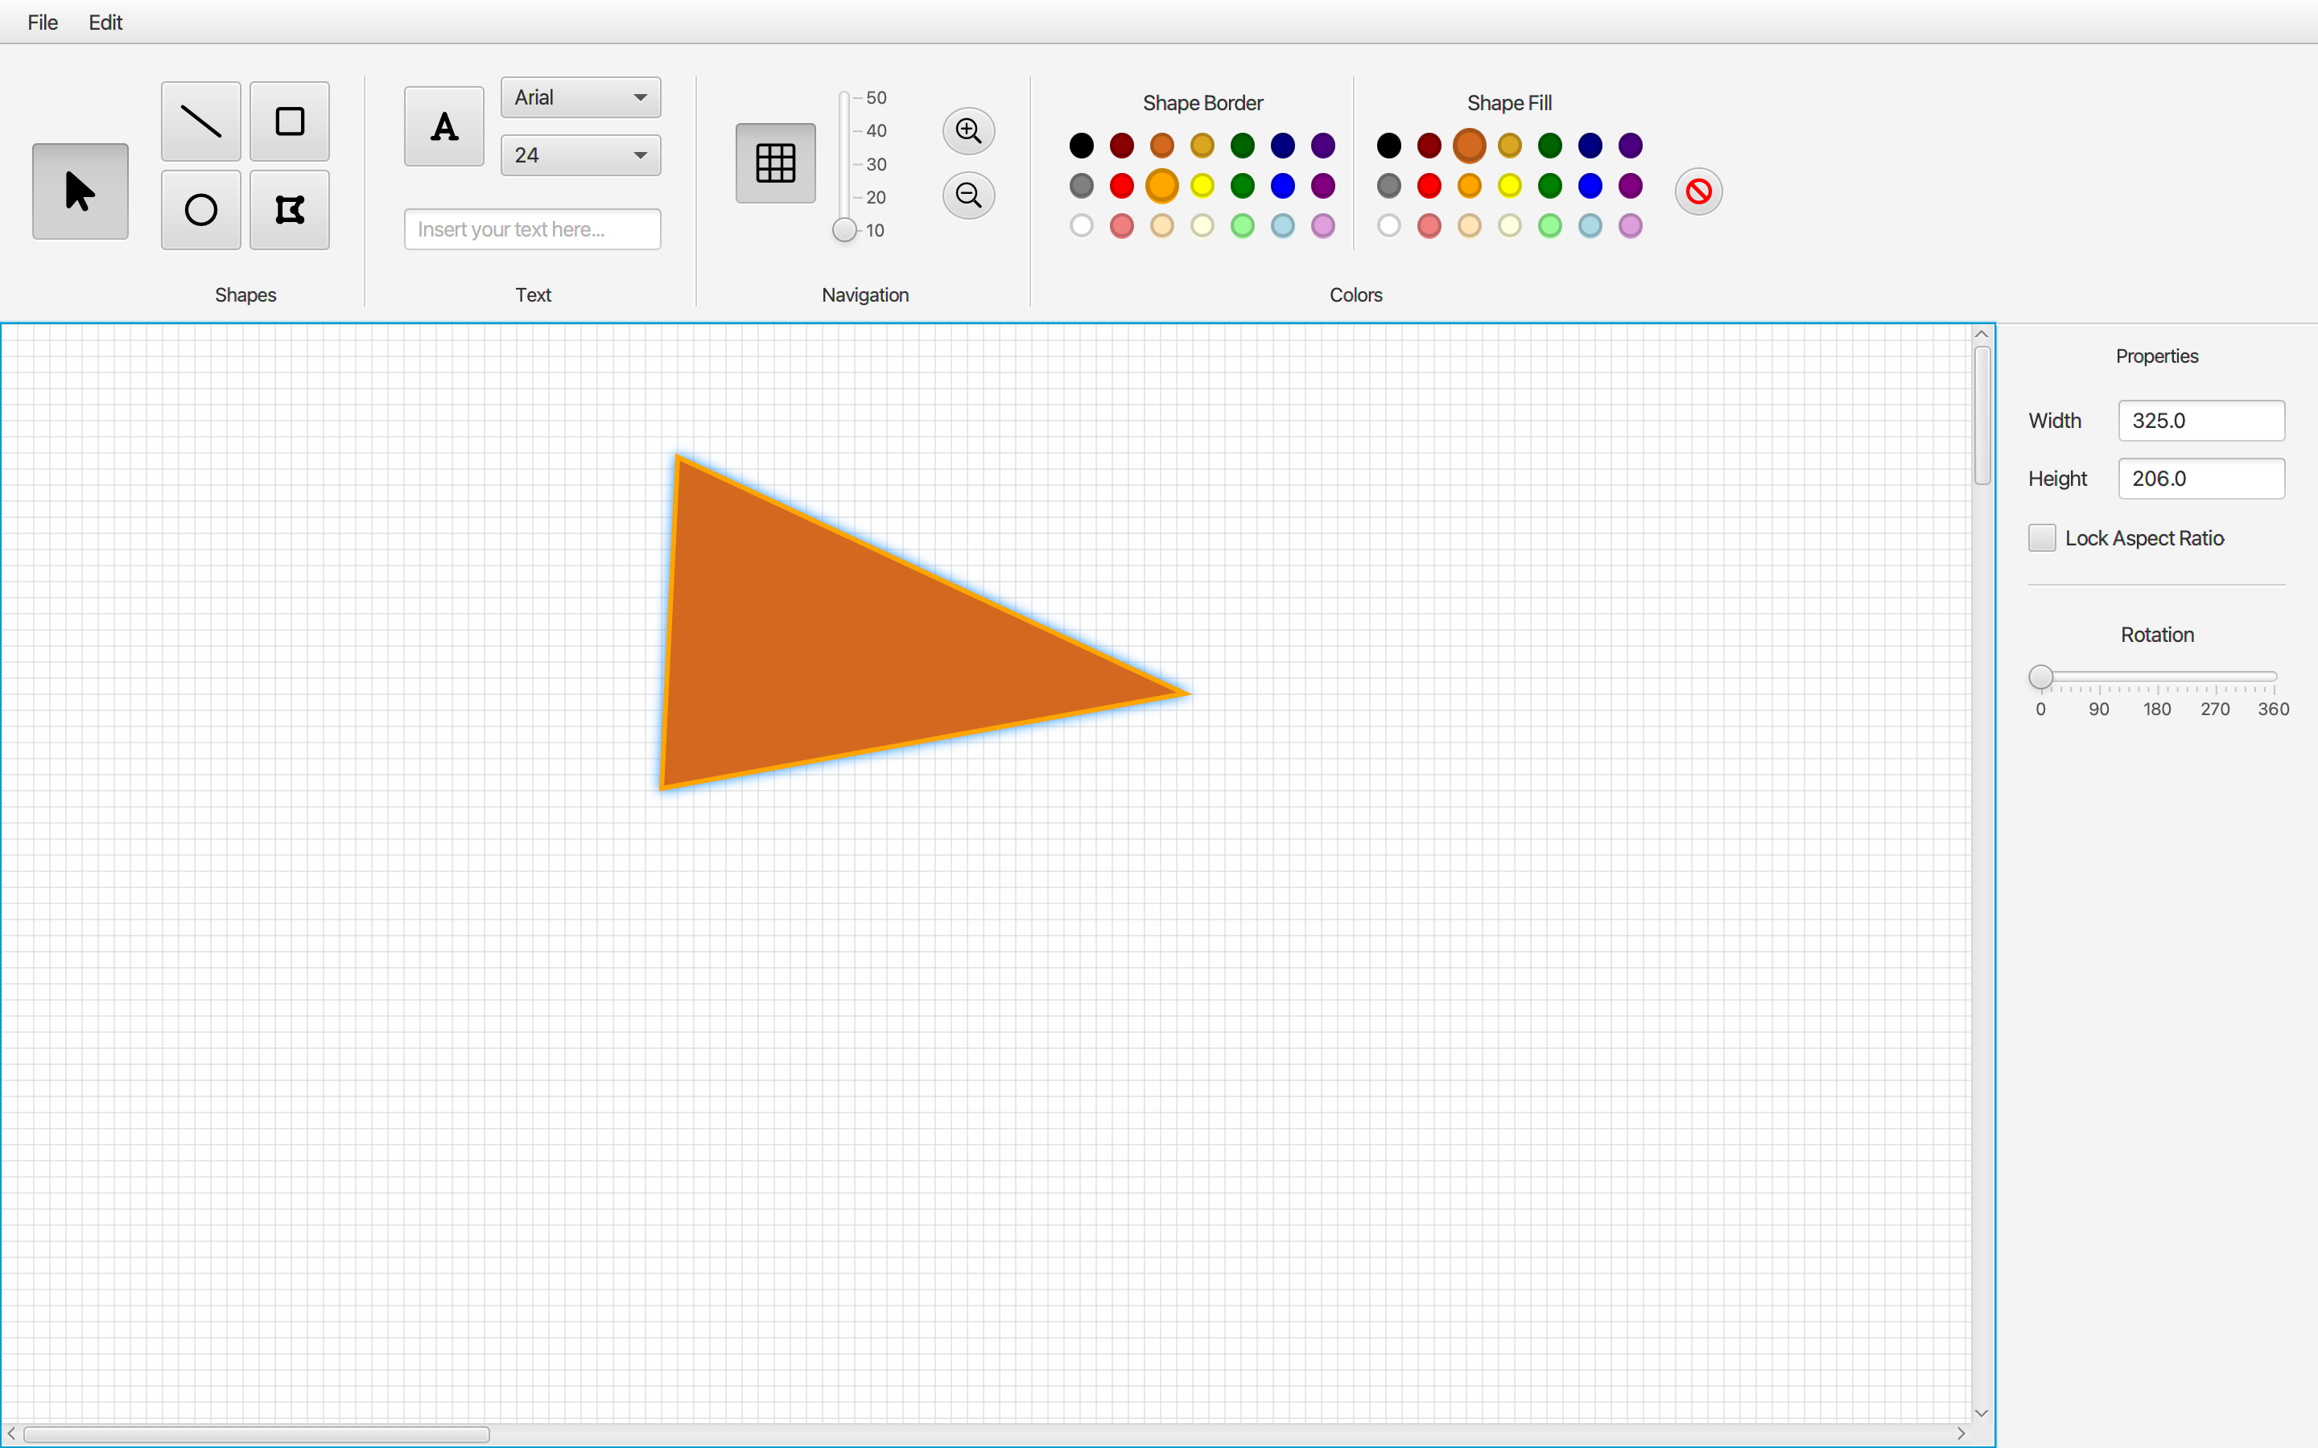
3rd sprint release
(Fig. 1) Mirror Horizontally functionality
(Fig. 2) Mirror Vertically functionality

Slide 3
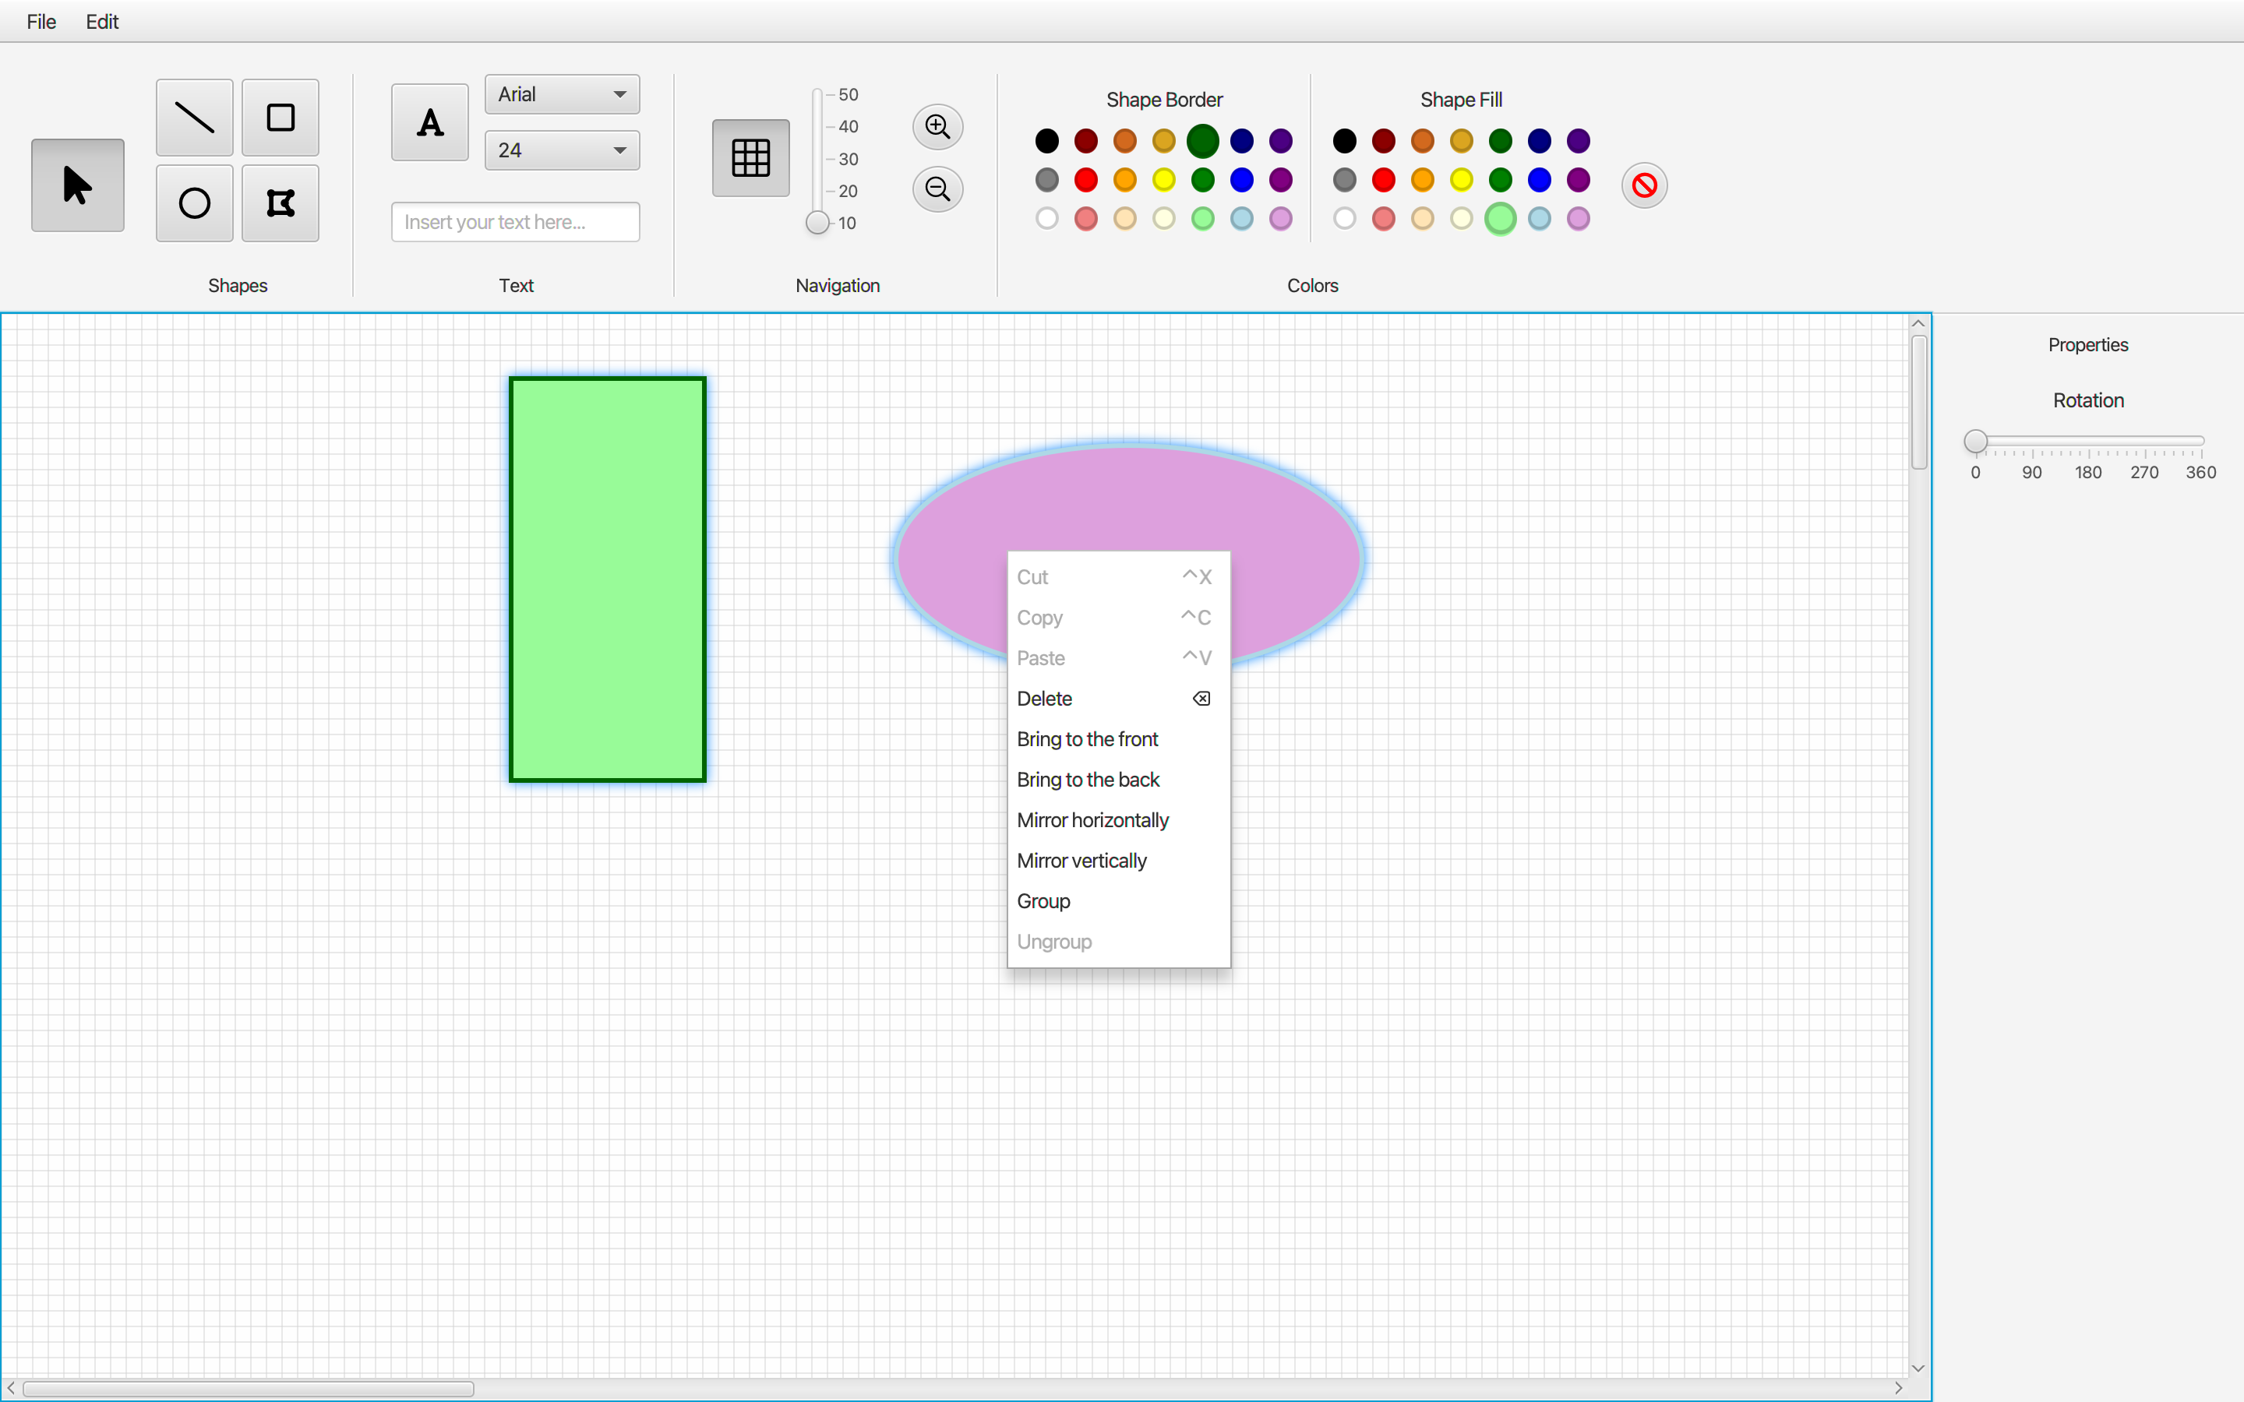
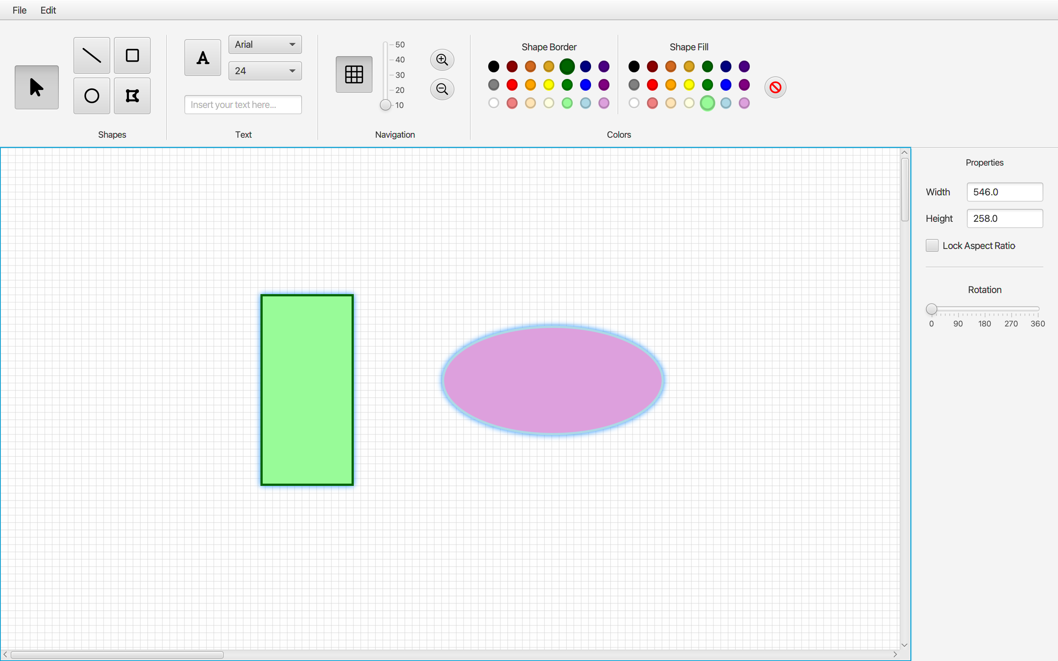
3rd sprint release
(Fig. 3) Selecting more shapes functionality
(Fig. 4) Group/Ungroup functionality

Slide 4
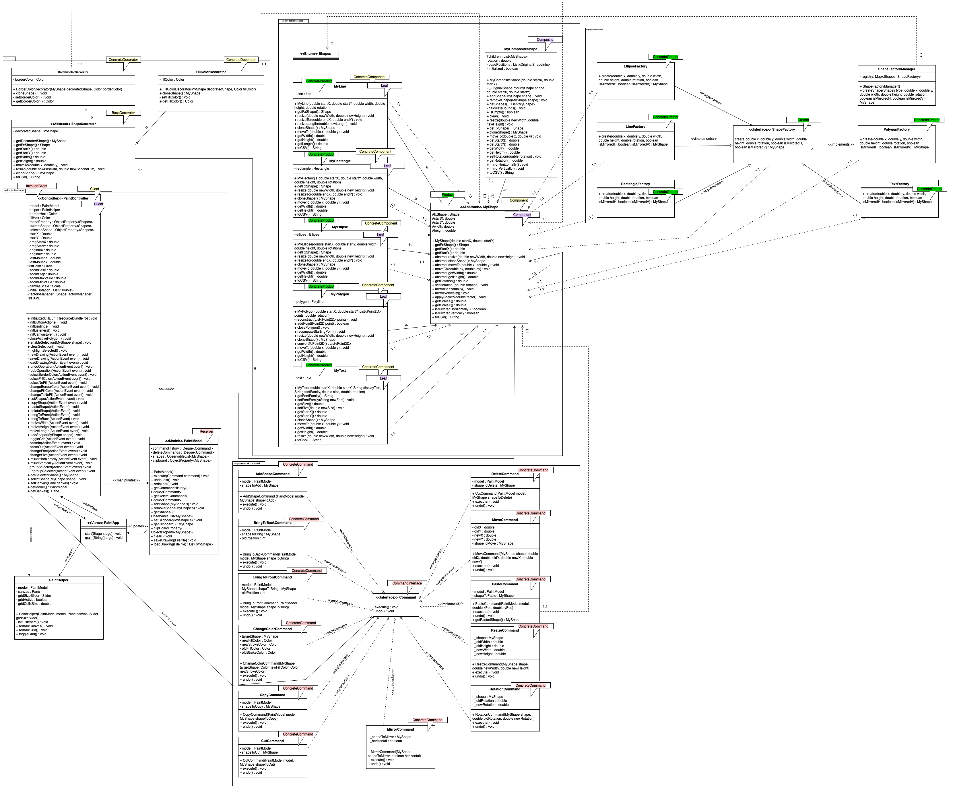
3rd sprint release - CLASS DIAGRAM
(Fig. 5) Class Diagram produced up 3rd sprint

Slide 5
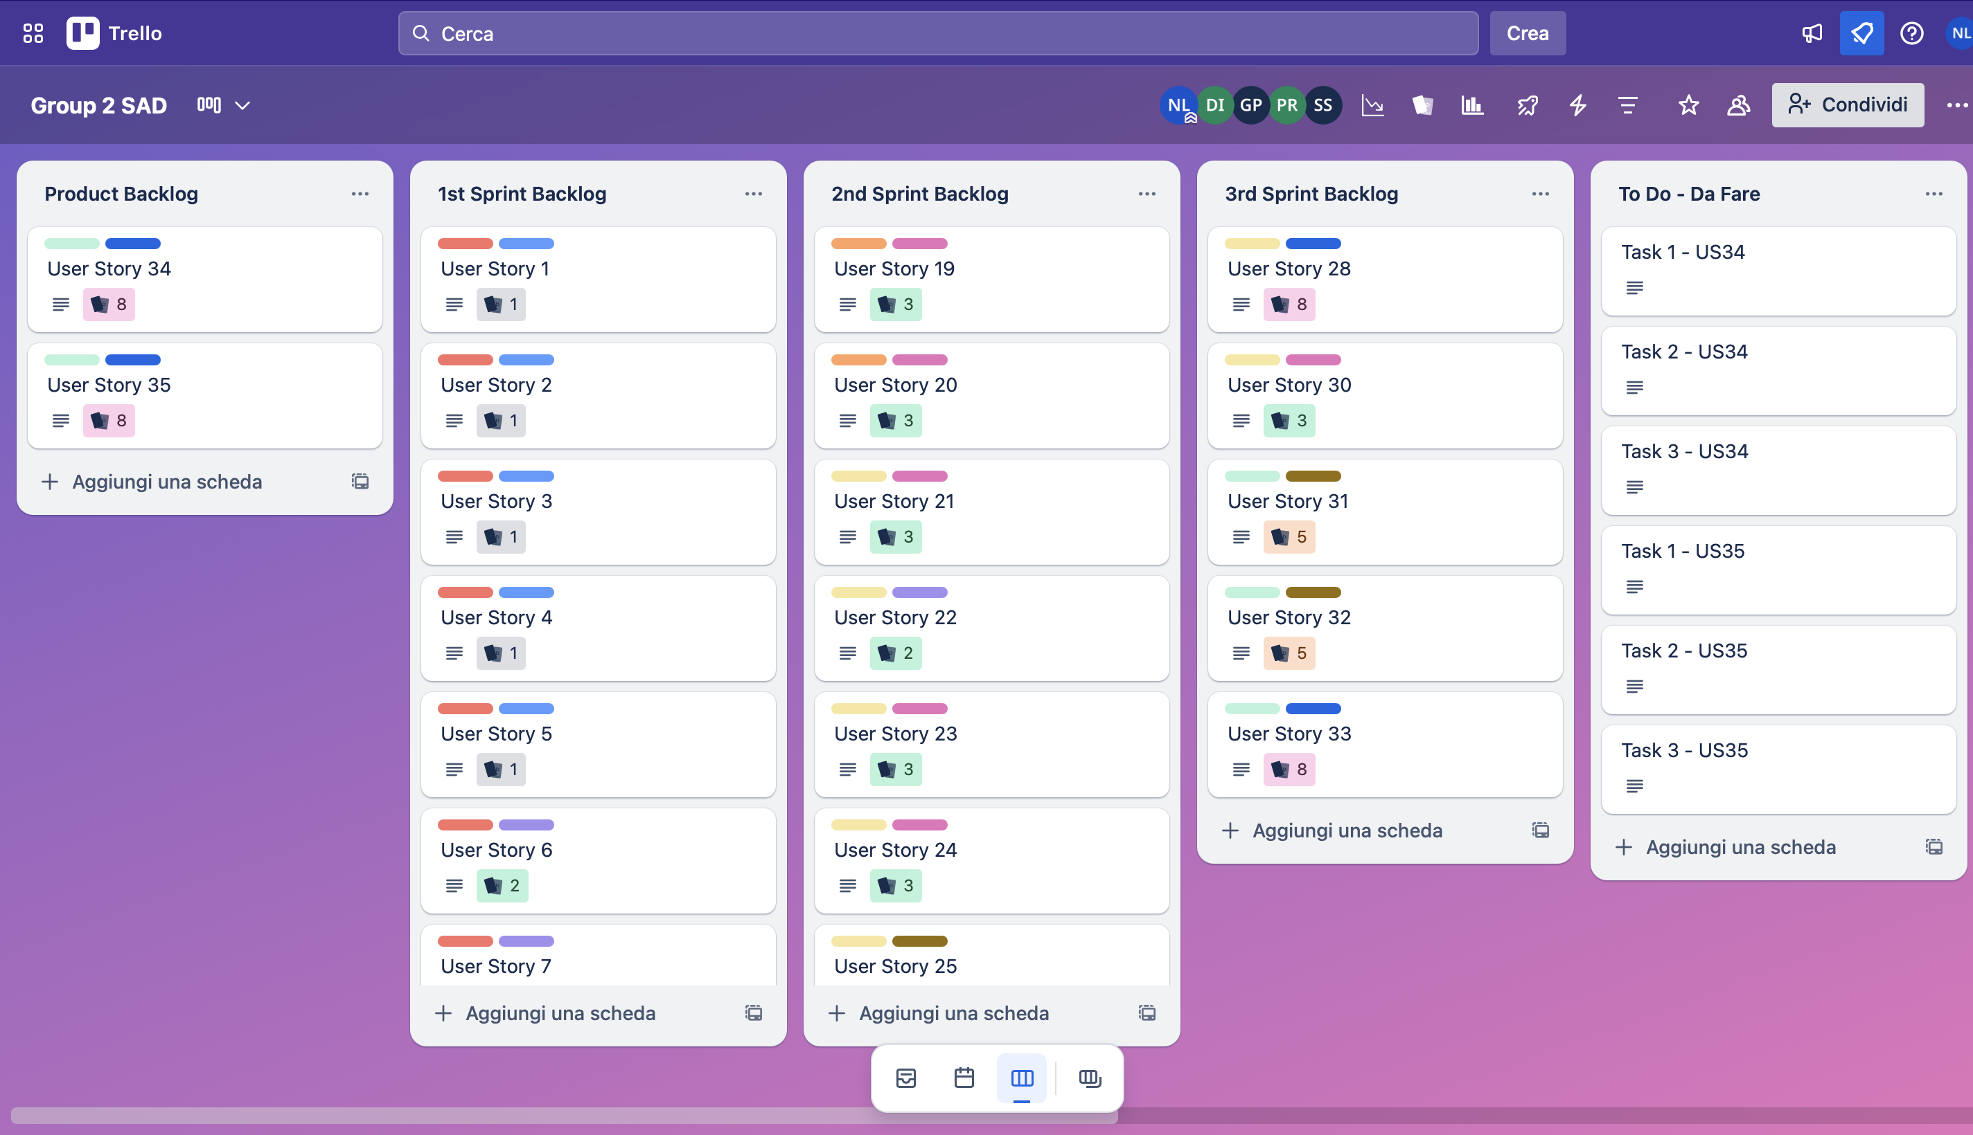
3rd sprint review
User Stories n. 28 and n. 30 through n. 32 were completed.
In addition, the following were introduced:
additional unit tests than those created in previous sprints;
the Factory Pattern, to facilitate future integration of new shapes without modifying the existing code, thus improving the extensibility and maintainability of the system.
(Fig. 6) Trello Board at the end of 3rd sprint

Slide 6
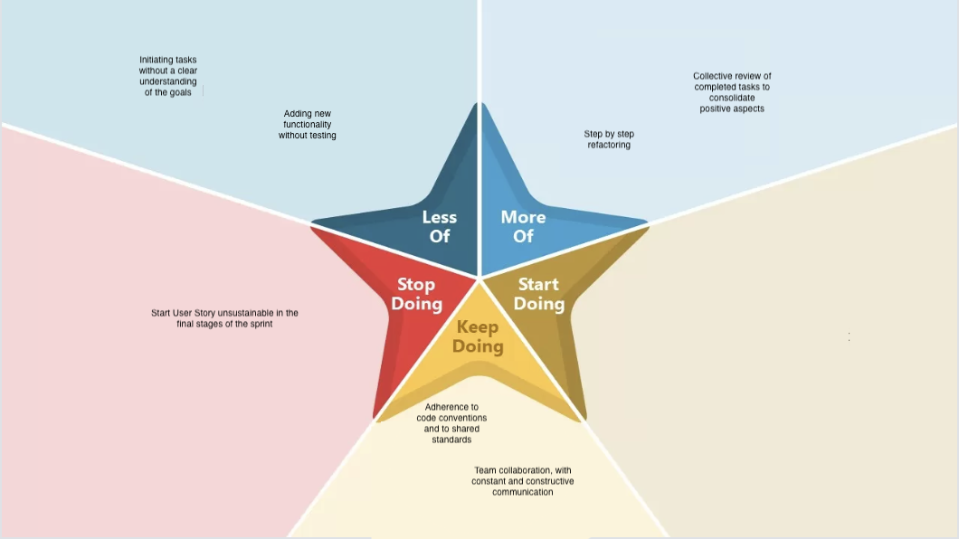
3rd sprint retrospective

Slide 7
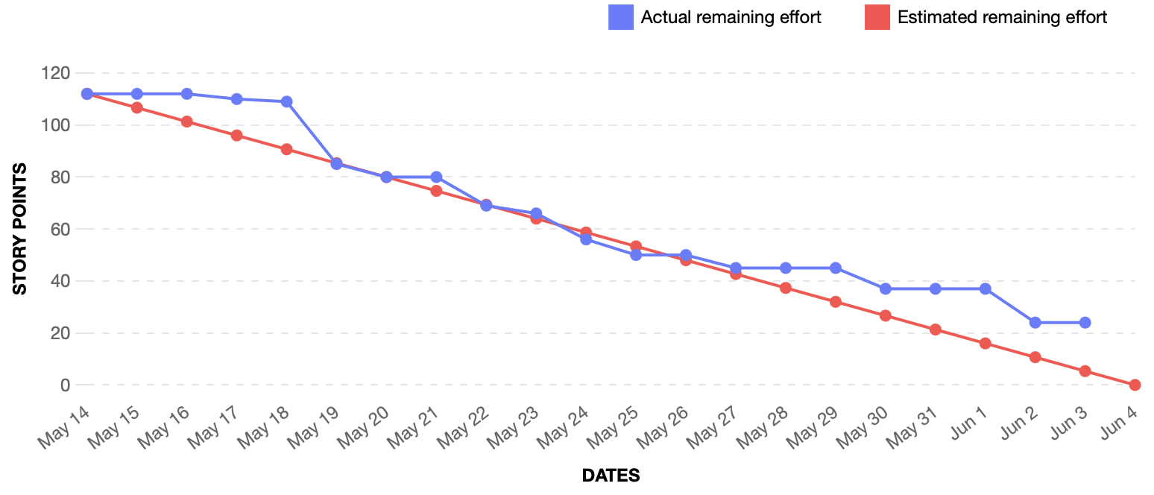
Burndown chart
(Fig. 7) Burndown chart at the end of 3rd sprint

Slide 8
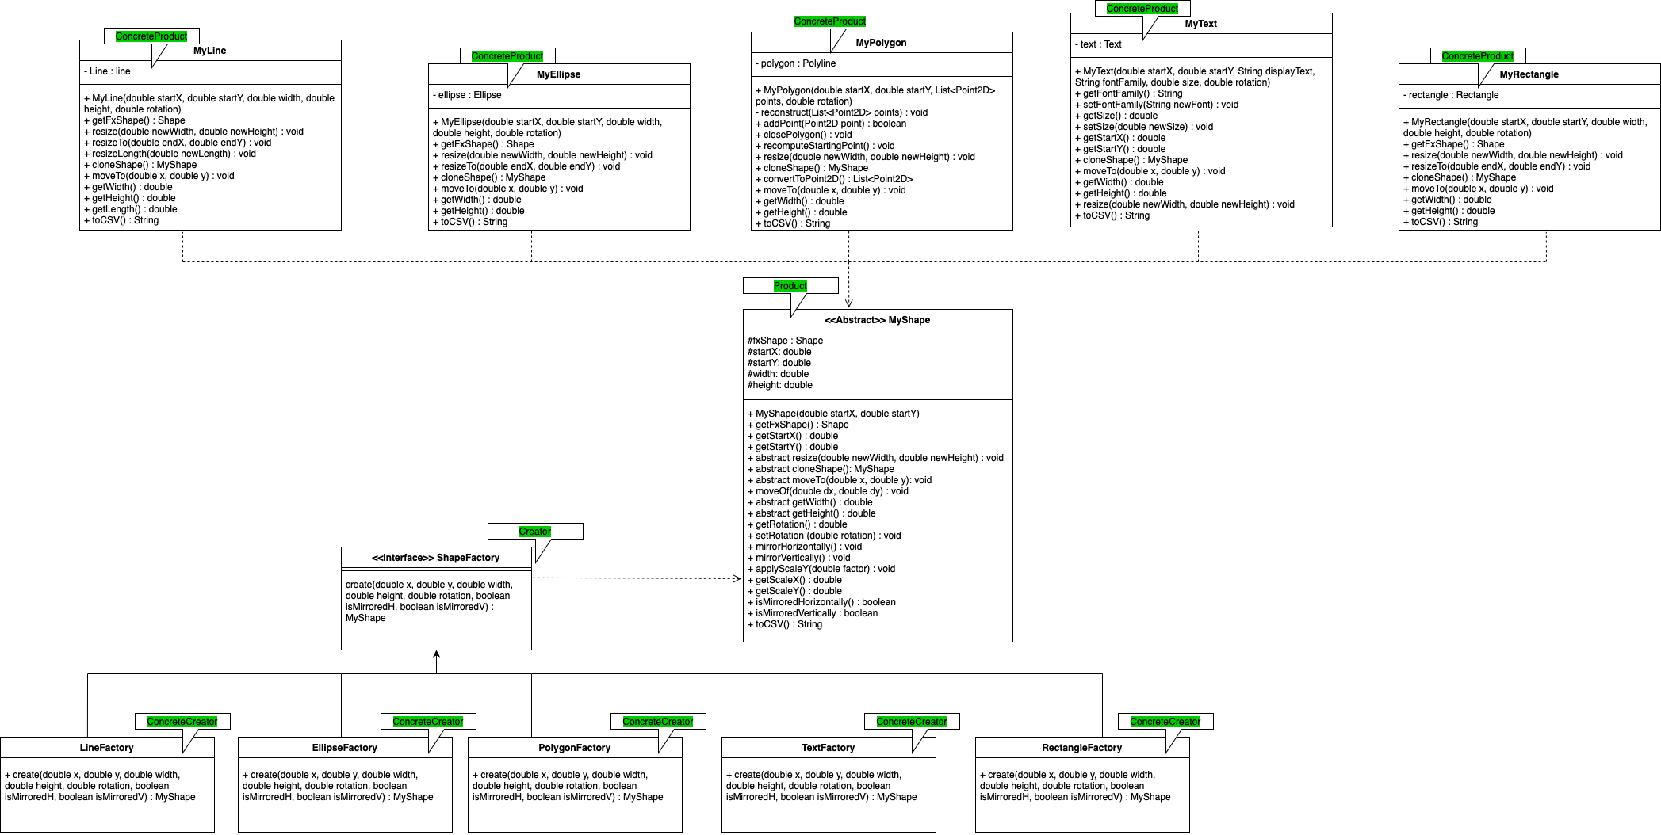
FINAL PATTERNS APPLIED
(Fig. 8) Factory Pattern

Slide 9
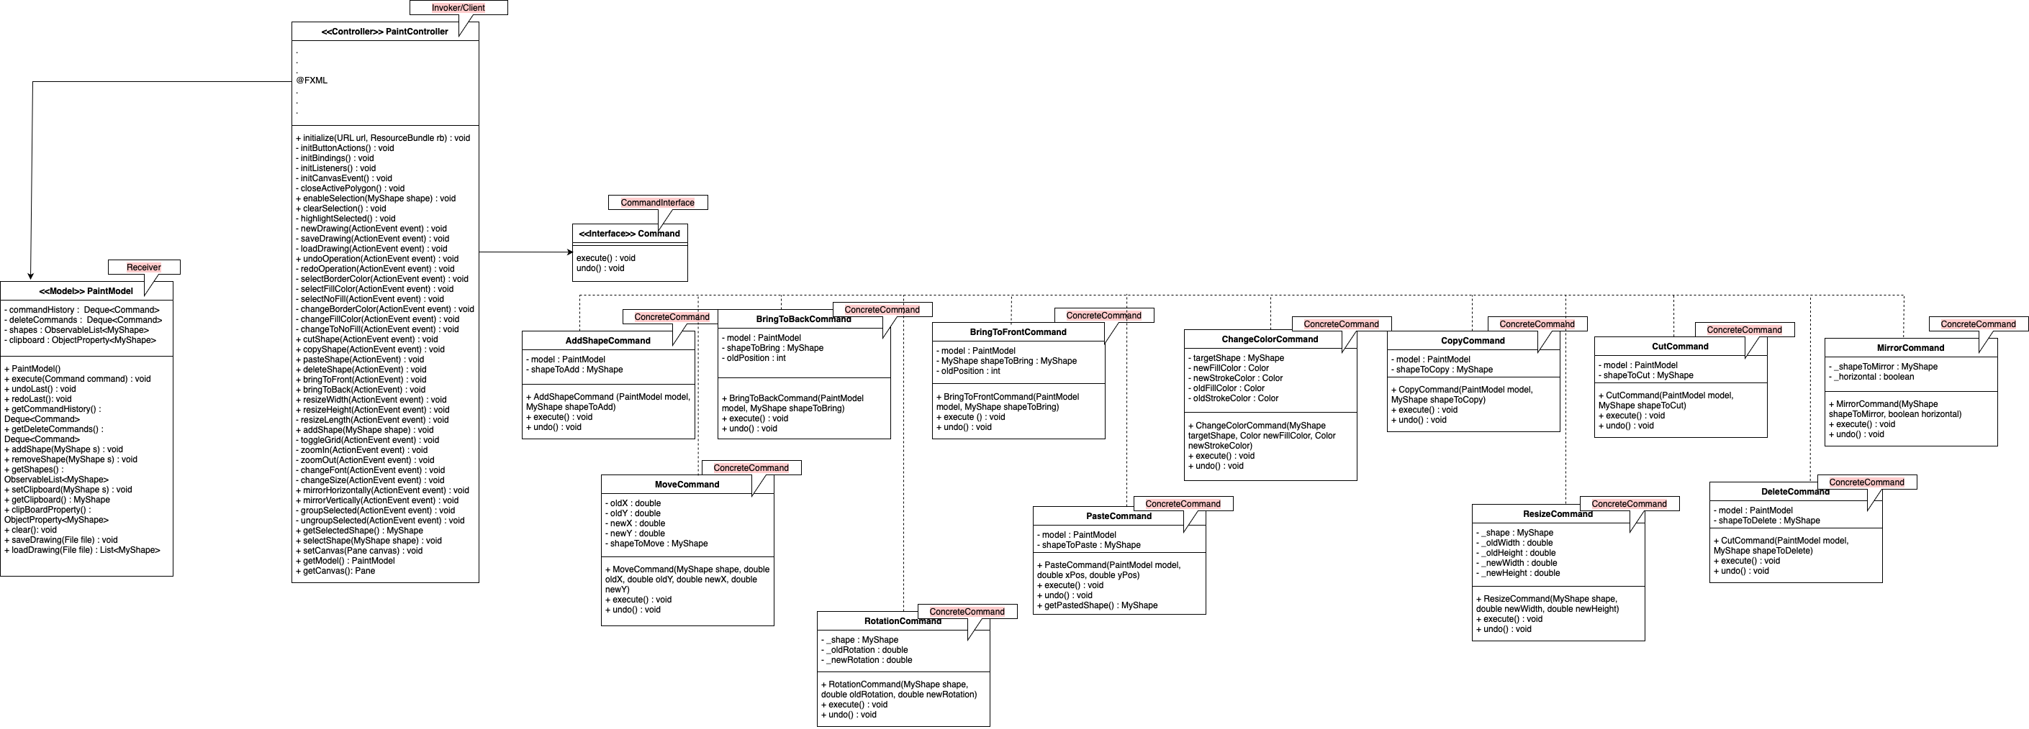
FINAL PATTERNS APPLIED
(Fig. 9) Command Pattern

Slide 10
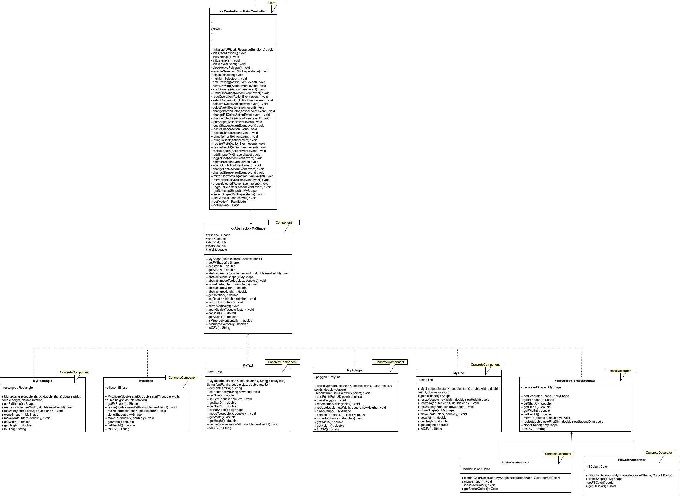
FINAL PATTERNS APPLIED
(Fig. 10) Decorator Pattern

Slide 11
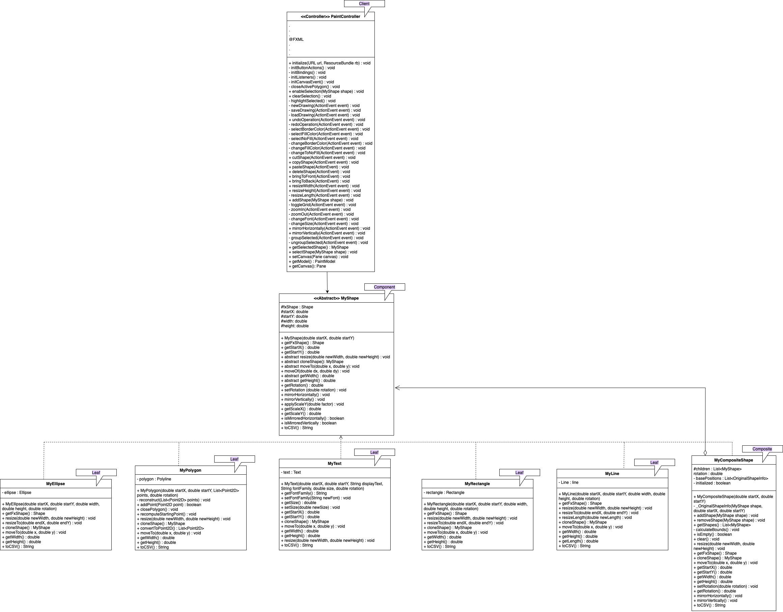
FINAL PATTERNS APPLIED
(Fig. 11) Composite Pattern

Slide 12
THANK YOU for attention
Iannone Davide
Lomazzo Noemi
Petrone Gianluca
Sirica Simone

